Slide 1




Let’s add occupants
to our digital twins!
Alex Donkers – PhD Candidate at Eindhoven University of Technology – a.j.a.donkers@tue.nl
Dujuan Yang, Bauke de Vries, Nico Baken

Slide 2




Slide 3


Slide 4

The probability that :JaneDoe suffers visual discomfort is 94%
The current amount of light is not sufficient for this task

Slide 5
While buildings should be designed for their occupants, many buildings fail to satisfy their expectations.
How to monitor building performance?
How to integrate the occupant?
How to create parallel intelligence?

Slide 6
How to monitor building performance?

Slide 7
Mean radiant temperature
Background noise level
Relative humidity
Clothing level
Communication privacy
Surface temperature
Air velocity
Reverberation time
Thermal comfort
Weather information
Acoustic comfort
Geometry of rooms and elements
Indoor Environmental Quality
Building topology
Visual comfort
Sociodemographics
Air quality
Glare
Metabolic rate
Natural ventilation
Natural light
Particulate matter
CO2 level
Artificial light
Activity level
Mood
Mechanical ventilation
Visual privacy
Occupant preferences

Slide 8
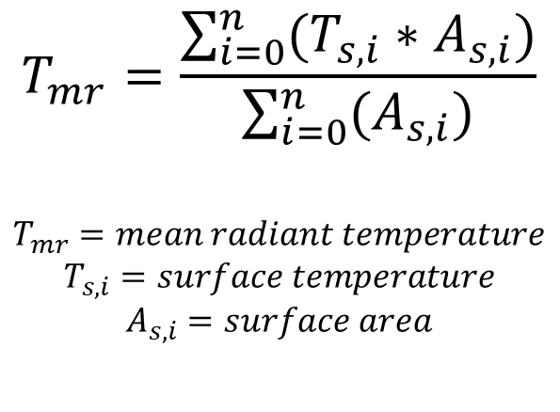
Mean radiant temperature
Sun intensity
Sun azimuth
Height of the sun
Surface tilt
Surface azimuth
T_{s,3}
$$T_{mr}=\frac{\sum_{i=0}^{n}{(T_{s,i}∗A_{s,i})}}{\sum_{i=0}^{n}{(A_{s,i})}}$$
$$T_{mr}=mean radiant temperature$$
$$T_{s,i}=surface temperature$$
$$A_{s,i}=surface area$$
A_{s,2} *
T_{s,2}
Thermal transmittance
T_{s,5}
T_{s,4}
T_{s,1}
Indoor air temperature
Indoor air velocity
Indoor heat transfer coefficient
Outdoor air temperature
Outdoor air velocity
Outdoor relative humidity

Slide 9
TOPOLOGY
Rooms
Elements
How they relate to each other
Challenge
STATIC PROPERTIES
Geometry
Material characteristics
Integrate the heterogeneous information related to building performance assessments.
DYNAMIC PROPERTIES
Sensor data
Weather data

Slide 10
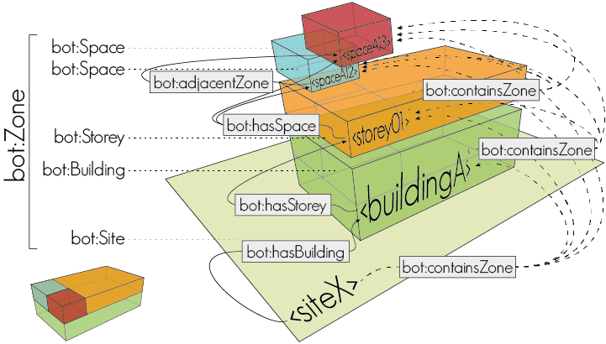
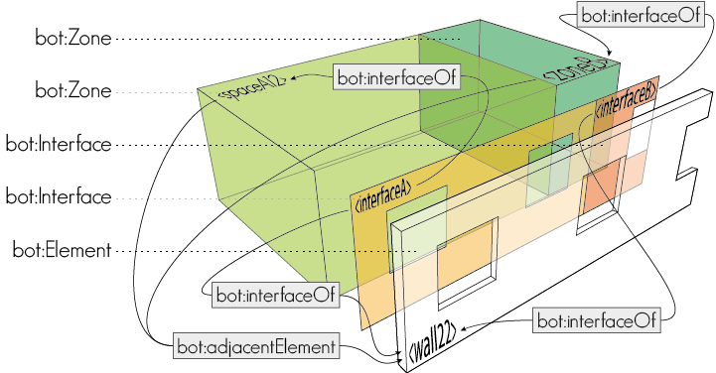
Building Topology Ontology (BOT)

Slide 11

Approaches to describe property values
READ MORE
Tang et al. (2019)
GRAPH DATABASE
GRAPH DATABASE
:Building
:Building
:hasSpace
:hasSpace
:Room
:Room
:hasSensor
:hasSensor
:Sensor01
:observes
:Temperature
:Sensor01
:observes
:Temperature
:timeSeriesReference
“InfluxDB-S01”
:hasResult
:hasResult
:Observation01
:Observation02
:value
:time
:value
:time
TIME-SERIES DATABASE
S01,21,1630575705
S01,21,1630575706
S01,22,1630575709
“21”
“1630575705”
“21”
“1630575706”

Slide 12
Static and dynamic properties
ONTOLOGIES FOR STATIC PROPERTIES
Ontology for Property Management (OPM)
BIM Design Ontology (BIMDO)
Building Product Ontology (BPO)
ONTOLOGIES FOR DYNAMIC PROPERTIES
Semantic Sensor Network Ontology (SSN)
Sensor, Observation, Sample and Actuator (SOSA)
Smart Applications REFerence Ontology (SAREF)
Brick
:FeatureOfInterest
:Sensor
:Property
:Observation
:Property
:PropertyState
Value
:FeatureOfInterest
:Result
Value

Slide 13
Properties: four levels of detail
hasProperty
FeatureOfInterest
^^cdt:datatype
Level 1
1 class, 1 datatype property
Level 2
2 classes, 1 object property,
1 datatype property
Property
^^xsd:decimal
FeatureOfInterest
hasResult
Unit
Level 3
3 classes, 2 object property,
1 datatype property
FeatureOfInterest
Property
PropertyState
^^xsd:decimal
Unit
Level 4
4 classes, 3 object property,
1 datatype property
FeatureOfInterest
Property
Execution
PropertyState
^^xsd:decimal
Unit

Slide 14
Building Performance Ontology (BOP)
rdfs:subClassOf
owl:ObjectProperty
owl:DatatypeProperty
rdfs:Class
rdfs:Literal
bop:Platform
Class
bop:hosts min 1/
bop:isHostedBy max 1
Literal
bop:implementsProcedure/
bop:implementedBy
bop:hasSubExecutor/
bop:isSubExecutorOf
bop:Procedure
bop:Executor
bop:executesOn/
bop:isExecutedBy
bop:hasExternalDatabase/
bop:isDatabaseOf
bop:Database
bop:usesProcedure/
bop:isUsedFor
bop:executedBy/
bop:performsExecution
bop:Execution
bop:hasExecutedProperty/
bop:hasExecution
bop:Property
bop:containsProperty /
bop:ispartOfPropertySet
bop:PropertySet
bop:hasSubProperty/
bop:isSubPropertyOf
bop:hasFeatureOfInterest/
bop:isFeatureOfInterestOf
hasProperty min 1/
isPropertyOf min 1
bop:hasDataPoint/
bop:isDataPointOf
bop:FeatureOfInterest
bop:hasExecutionState/
bop:isExecutionStateOf
bop:hasComplexProperty/
bop:isComplexPropertyOf
bop:hasPropertyState/
bop:isPropertyStateOf
rdfs:subPropertyOf bop:hasResult
rdfs:subPropertyOf bop:isResultOf
rdfs:subPropertyOf bop:hasSimpleResult
bop:hasSimpleExecutionState
bop:hasSimpleProperty
bop:hasSimplePropertyState
Unit
bop:hasSimpleUnit max 1
bop:Result
bop:hasValue max 1
Value
bop:hasUnit max 1/
bop:isUnitOf
bop:hasID max 1
ID
bop:Unit
bop:DataPoint
prov:generatedAtTime
TimeOfGeneration
bop:Input
bop:Output
bop:UserDefined
^^xsd:dateTime

Slide 15

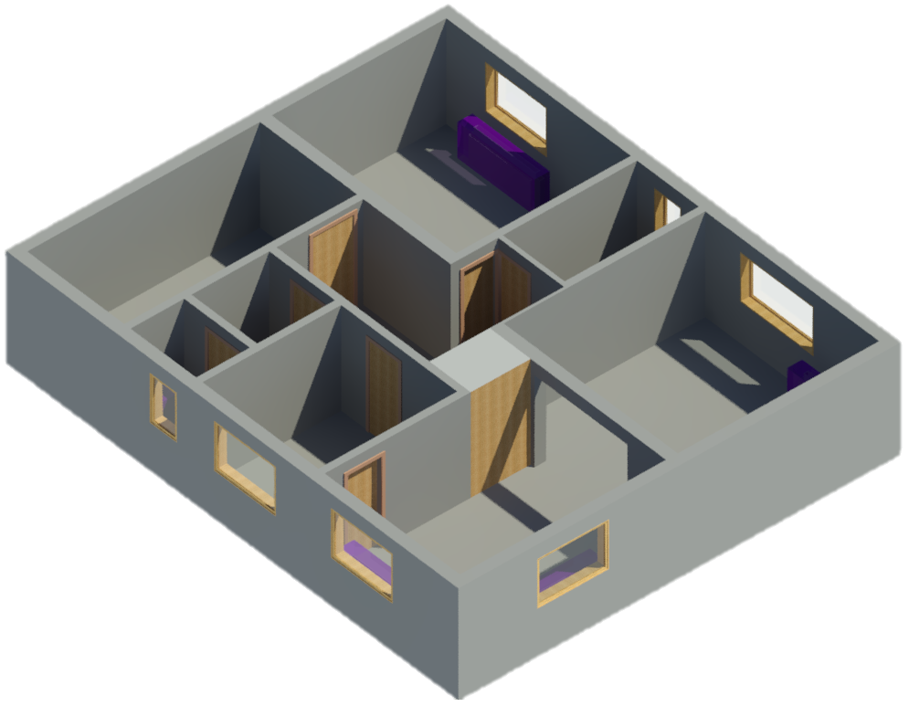
Convert to linked data
Link to external DB
TOPOLOGY
Rooms
Elements
:Room_01
bop:FeatureOfInterest
12:00 21
12:10 21
12:20 22
12:40 21
bot:adjacentElement
bot:adjacentElement
:Wall_02
bop:FeatureOfInterest
:Wall_01
bop:Platform
STATIC PROPERTIES
Geometry
Material characteristics
:TemperatureSensor_01
bop:Sensor
bop:hosts
bop:hasProperty
:Wall_02_Length
bop:Property
bop:hasPropertyState
_:bn
bop:Result
bop:hasValue
“12.0”
bop:hasUnit
:M
bop:Unit
DYNAMIC PROPERTIES
Sensor data
Weather data
:Room_01_Temperature
bop:Property
bop:hasPropertyState
“OSH_T_0001”
:R01_T_Point
bop:DataPoint
bop:hasID
:DEG_C
bop:Unit, unit:DEG_C
:OSH_TSDB
ofo:Database
bop:hasUnit
bop:isDataPointOf
RULES AND REGULATION
PMV
PPD
PYTHON
Real-time building performance monitoring

Slide 16
GEOMETRY GraphDB
sparql.setQuery("""PREFIX props: <https://w3id.org/props#>
PREFIX quantitykind: <http://qudt.org/vocab/quantitykind/>
PREFIX bot: <https://w3id.org/bot#>
PREFIX bop: <https://w3id.org/bop#>
PREFIX beo: <http://pi.pauwel.be/voc/buildingelement#>
PREFIX : <https://research.tue.nl/nl/persons/alex-ja-donkers#>
SELECT ?room ?wall ?interface ?interfaceWidthValue
WHERE {
?room bop:hasSimplePropertyState "Bedroom" ;
bot:adjacentElement ?wall .
?wall a beo:Wall .
?interface bot:interfaceOf ?room, ?wall ;
bop:hasProperty ?width .
?width a quantitykind:Width ;
bop:hasPropertyState / bop:hasValue ?interfaceWidthValue
} """)

Slide 17
TEMPERATURE GraphDB
graph_url = "http://localhost:7200/repositories/OpenSmartHomeRepository"
sparql = SPARQLWrapper(graph_url)
sparql.setQuery("""PREFIX props: <https://w3id.org/props#>
PREFIX quantitykind: <http://qudt.org/vocab/quantitykind/>
PREFIX bot: <https://w3id.org/bot#>
PREFIX bop: <https://w3id.org/bop#>
PREFIX : <https://research.tue.nl/nl/persons/alex-ja-donkers#>
SELECT ?property ?datapoint ?database
WHERE {
?room bop:hasSimplePropertyState "Bedroom" ;
bot:containsElement ?sensor .
?sensor bop:observes ?property .
?property a quantitykind:Temperature ;
bop:hasPropertyState ?datapoint .
?datapoint bop:isDataPointOf ?database .
} """)

Slide 18
TEMPERATURE InfluxDB
client = InfluxDBClient(host='localhost', port=8086)
client.switch_database(database)
resultset = client.query(
'SELECT ‘ + property + ’ FROM ’ + datapoint + ‘ WHERE time <= ‘ + str(maxTime) + ‘ AND time > ‘ + str(minTime) + ‘ ORDER BY time DESC LIMIT 1’)
value = list((resultset.get_points(measurement=datapoint)))
temperature = value[0]['value']

Slide 19
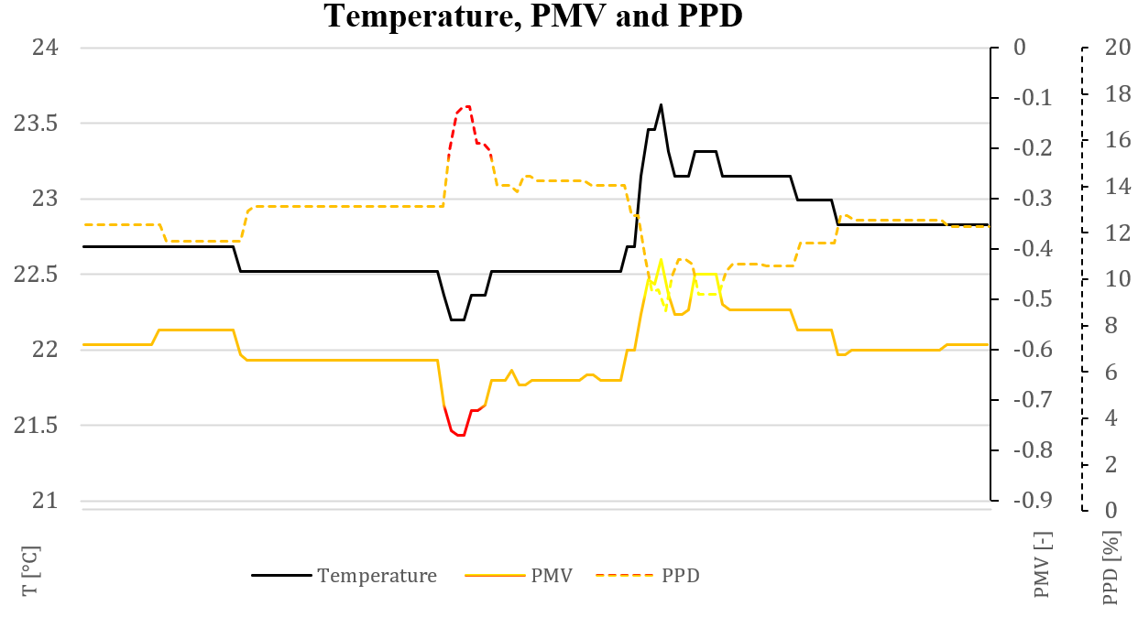
Results: PMV and PPD

Slide 20
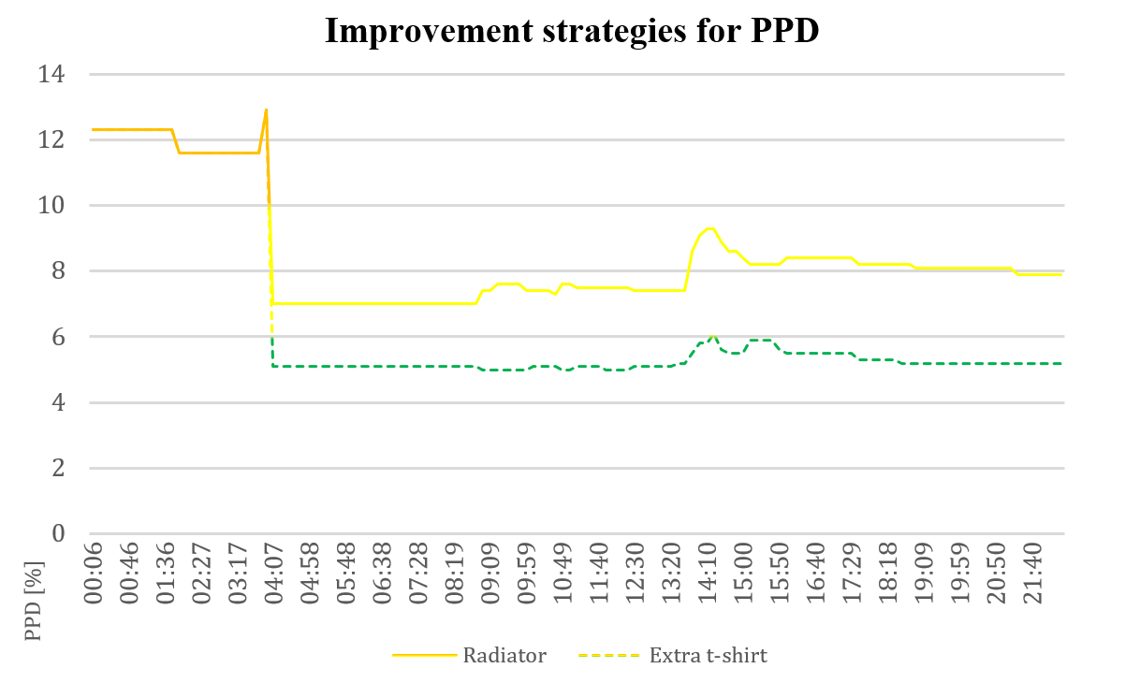
Results: PMV and PPD improvements

Slide 21
How to integrate the occupant?

Slide 22




Mintal
17:30:22
Kitchen
LivingRoom
Office
v
v
CO2

Slide 23
In-app data querying
In-app RDF converter
Store and link to external DB
LOCALIZATION
“John Doe”
12:00 60 Like
12:10 61 Like
12:20 65 Dislike
12:40 65 Like
:Kitchen
ofo:FeatureOfInterest,
ofo:Location, bot:Space
“01-12-1994”
ofo:hasLocation
:JohnDoe
ofo:Person, ofo:FeatureOfInterest
“Male”
OCCUPANT INFO
Name
Birthday
Gender
Height
“1.78”
ofo:wears
:FitbitOfJohnDoe
ofo:Smartwatch
ofo:isPropertyOf
:JohnDoe_HeartRate
bop:HeartRate
MEDICAL DATA
Sensor data measured by smartwatch
:HZ
ofo:Unit, unit:HZ
ofo:hasPropertyState
ofo:hasUnit
ofo:hasPropertyState
:JohnDoe_HR_DataPoint
ofo:DataPoint
ofo:isDataPointOf
ofo:hasFeedback
:JohnDoe_TSDB
ofo:Database
:JohnDoe_Kitchen_ThermalComfort_Feedback
ofo:Feedback
FEEDBACK
Complaints
Likes
ofo:onProperty
:Kitchen_ThermalComfort
ofo:ThermalComfort
:UNITLESS
ofo:Unit, unit:UNITLESS
ofo:hasPropertyState
ofo:hasUnit
ofo:isDataPointOf
:JohnDoe_TCF_DataPoint
ofo:DataPoint
https://w3id.org/ofo

Slide 24


Mintal resulting data structure
ofo:hasUnit
:HZ
ofo:Unit
ofo:hasPropertyState
ofo:observes
:JohnDoeHeartRateDataPoint
ofo:DataPoint
:JohnDoeHeartRate
bop:Property
ofo:isDataPointOf
ofo:isPropertyOf
ofo:wears
:JohnDoe_FitbitSense
ofo:Smartwatch
ofo:hasHeight
ofo:hasLocation
:JohnDoe_TSDB
ofo:Database
:JohnDoe
ofo:Person, ofo:FeatureOfInterest
ofo:hasLocation
ofo:isDataPointOf
“1.78”
:Kitchen
ofo:FeatureOfInterest,
ofo:Location, bot:Space
ofo:hasFeedback
:UNITLESS
ofo:Unit
ofo:hasUnit
:JohnDoe_Kitchen_TCF_DataPoint
ofo:DataPoint
:JohnDoe_Kitchen_ThermalComfortFeedback
ofo:Feedback
ofo:hasFeedbackResult

Slide 25
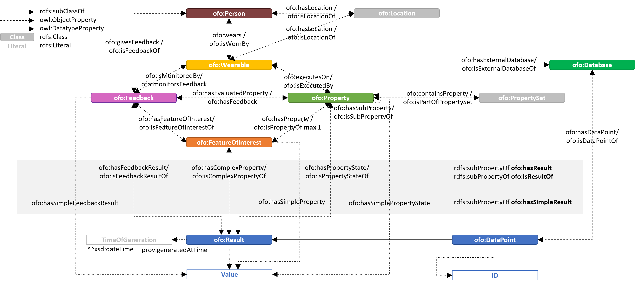
Occupant Feedback Ontology (OFO)

Slide 26
Querying with OFO
CQ1: What active feedback is given by the occupant?
SPARQL
PREFIX ofo: <https://w3id.org/ofo#>
SELECT ?comfortProperty ?feedback ?dataPoint ?database
WHERE {
:JohnDoe ofo:givesFeedback ?feedback .
?feedback ofo:hasEvaluatedProperty ?comfortProperty .
?comfortProperty a ofo:Property .
?feedback ofo:hasResult ?dataPoint .
?dataPoint ofo:isDataPointOf ?database . }
InfluxDB
USE ?database SELECT ?feedback FROM ?dataPoint ORDER BY time DESC LIMIT 1

Slide 27
Querying with OFO
CQ2: What passive feedback is measured by the wearable?
SPARQL
PREFIX ofo: <https://w3id.org/ofo#>
PREFIX opt: <https://alexdonkers.github.io/opt#>
SELECT ?personalProperty ?dataPoint ?database
WHERE {
:JohnsFitbit ofo:executesOn ?personalProperty .
?personalProperty a opt:PersonalProperty .
?personalProperty ofo:hasResult ?dataPoint .
?dataPoint ofo:isDataPointOf ?database . }
InfluxDB
USE ?database SELECT ?personalProperty FROM ?dataPoint ORDER BY time DESC LIMIT 1

Slide 28
Querying with OFO
CQ3: What location or object is the feedback referring to?
SPARQL
PREFIX ofo: <https://w3id.org/ofo#>
SELECT ?feedback ?foi
WHERE {
:JohnDoe ofo:givesFeedback ?feedback .
?feedback ofo:hasFeatureOfInterest ?foi . }
InfluxDB
PREFIX ofo: <https://w3id.org/ofo#>
SELECT ?location ?dataPoint ?database
WHERE {
:JohnDoe ofo:hasLocation ?location .
?location ofo:hasDataPoint ?dataPoint .
?dataPoint ofo:isDataPointOF ?database . }

Slide 29
Querying with OFO
CQ5: What feedback was given to a FOI between time t1 and t2?
SPARQL
SELECT ?feedback ?result ?resultTime
WHERE {
?feedback ofo:hasResult ?result .
?result prov:generatedAtTimev ?resultTime .
BIND(xsd:dateTime(NOW()) AS ?now) .
FILTER (YEAR(xsd:dateTime(?resultTime)) >
(YEAR(?now) - 3)) }
InfluxDB
USE ?database
SELECT ?feedback FROM ?dataPoint WHERE time > ?t1 and time <= ?t2

Slide 30
Querying with OFO
CQ6: What feedback is given to the properties related to a specific IEQ parameter?
SPARQL
SELECT ?database ?feedback ?dataPoint .
WHERE {
:ThermalComfortPropertySet ofo:containsProperty ?property .
?property ofo:hasFeedback / ofo:isFeedbackOf :JohnDoe .
?feedback ofo:hasResult ?dataPoint . }
SPARQL
SELECT ?database ?feedback ?dataPoint
WHERE {
:ThermalComfortPropertySet
ofo:containsProperty ?property .
?property ofo:hasFeedback ?feedback .
?feedback ofo:isFeedbackOf ?person .

Slide 31
Querying with OFO
CQ7: What passive feedback is measured by the wearable during the active feedback of the occupant?
SPARQL
PREFIX ofo: <https://w3id.org/ofo#>
SELECT ?property ?dataPoint ?database
WHERE {
:ThermalComfortPropertySet ofo:containsProperty ?property .
{ ?property ofo:isPropertyOf :JohnDoe . }
UNION
{ ?property ofo:hasFeedback / ofo:isFeedbackOf :JohnDoe . }
?property ofo:hasResult ?dataPoint . }

Slide 32
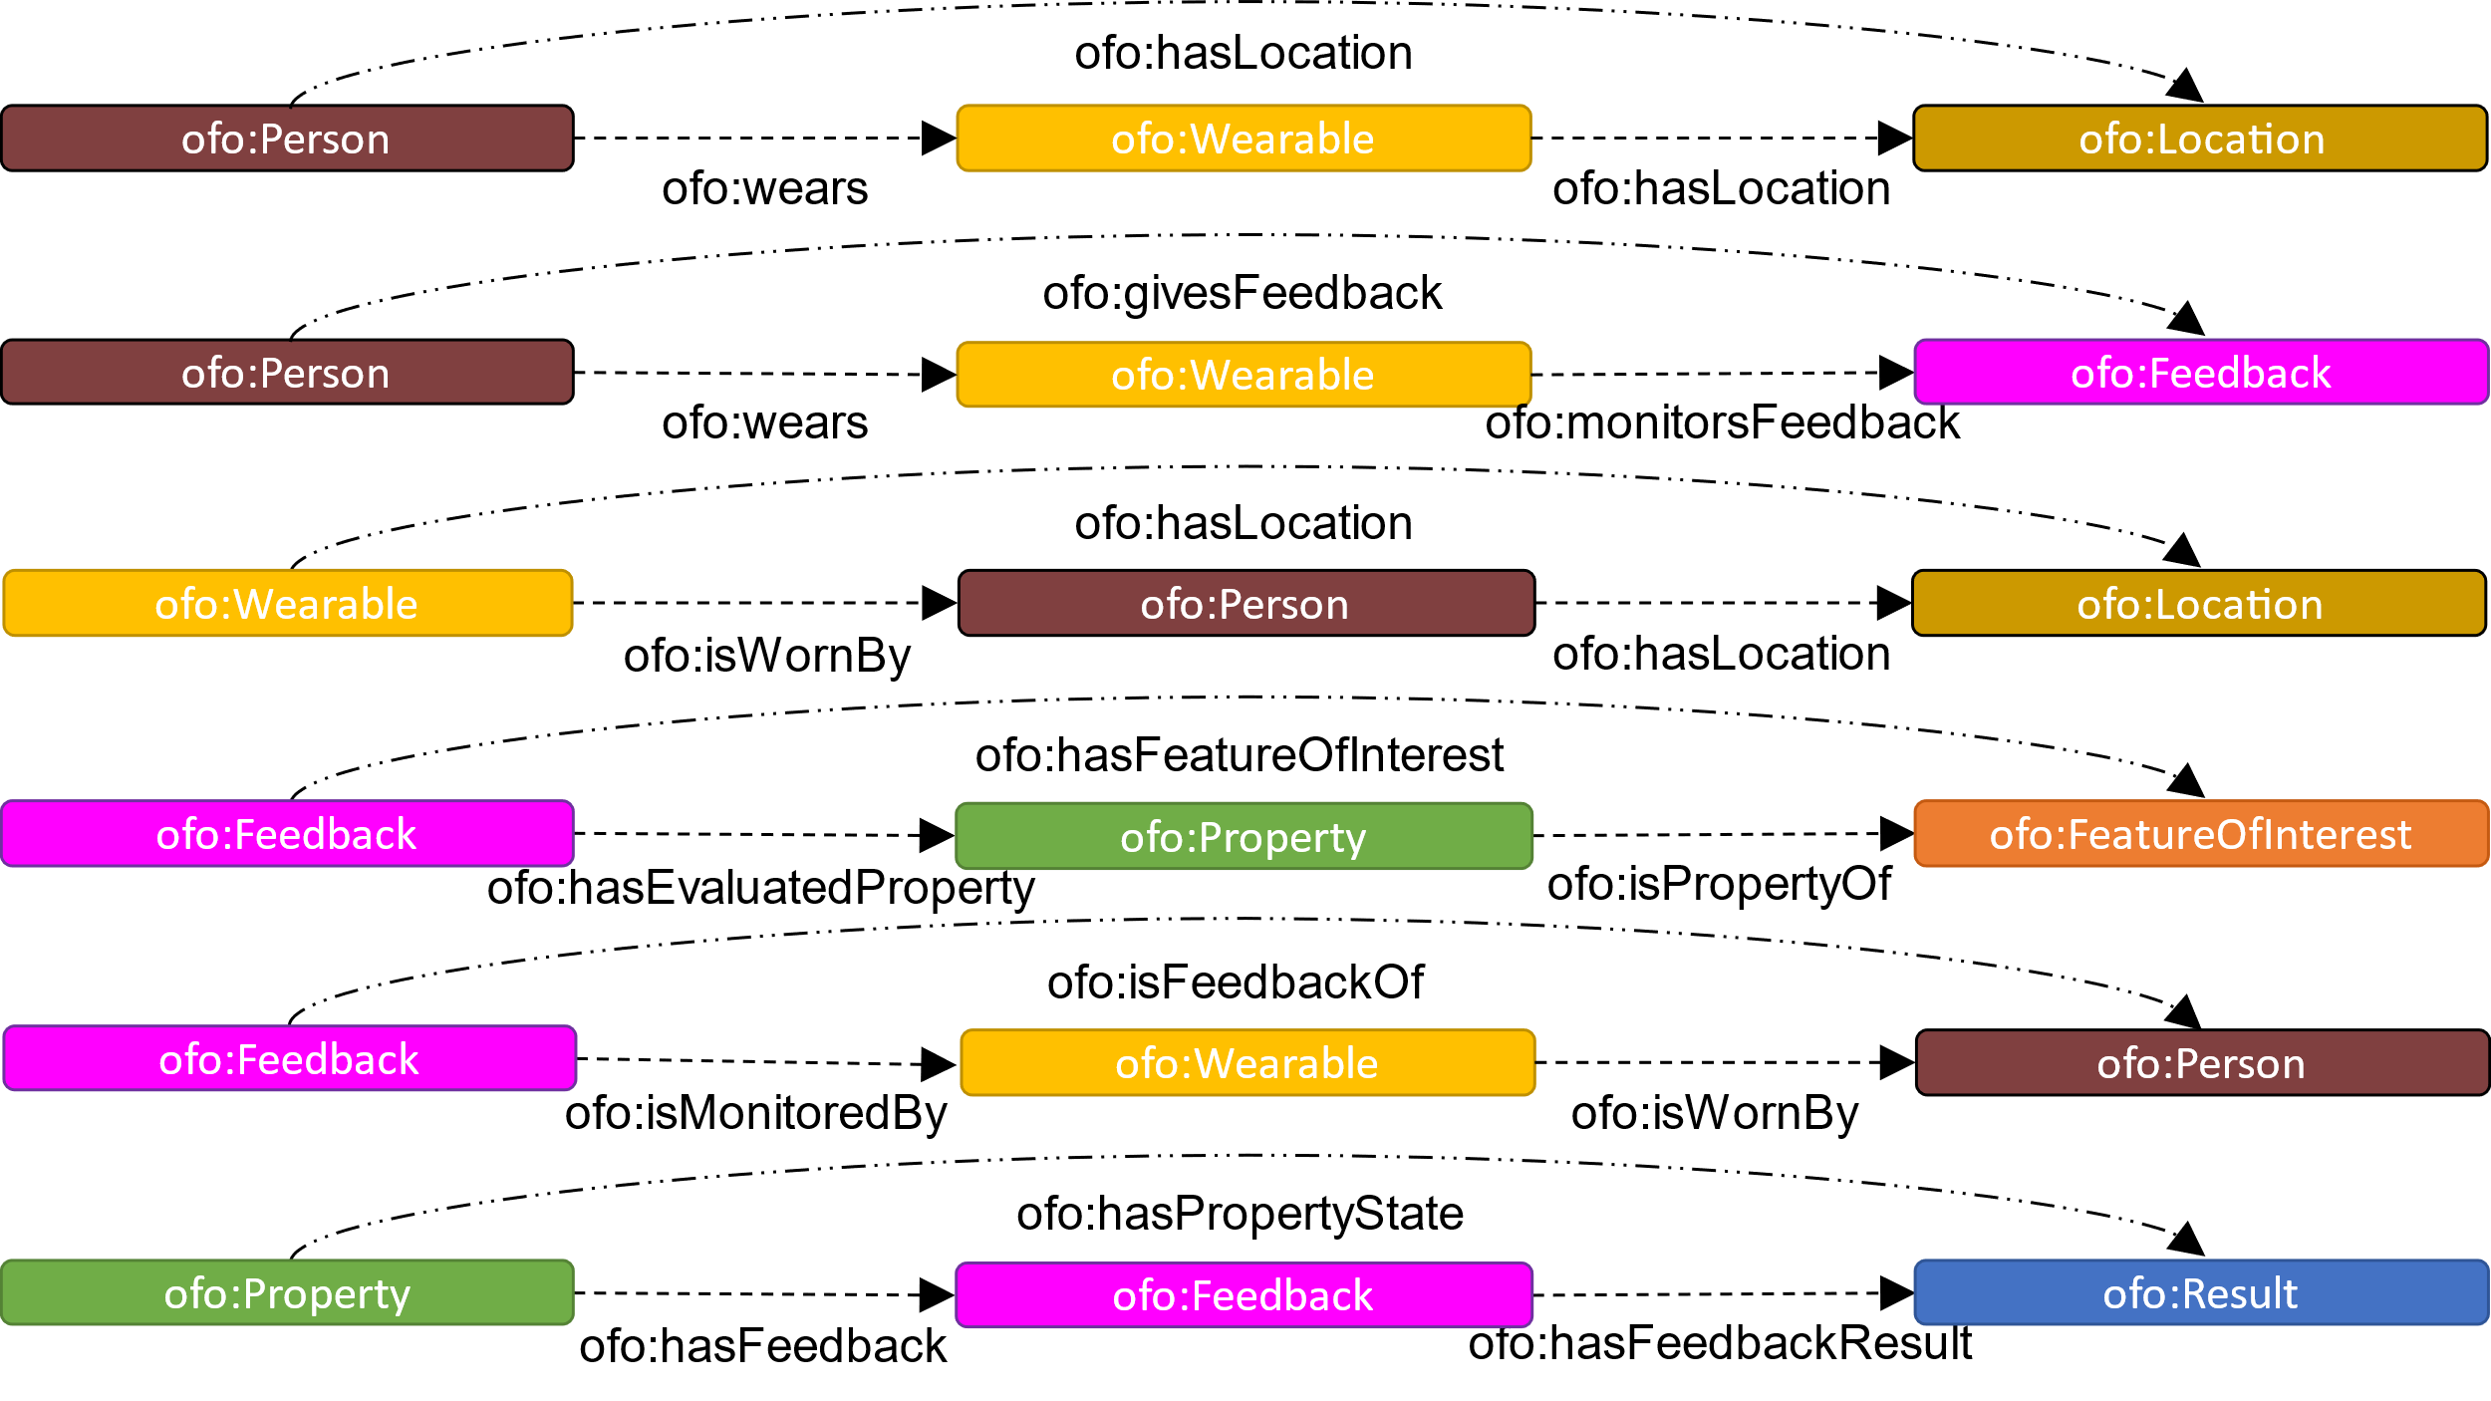
Property chains

Slide 33
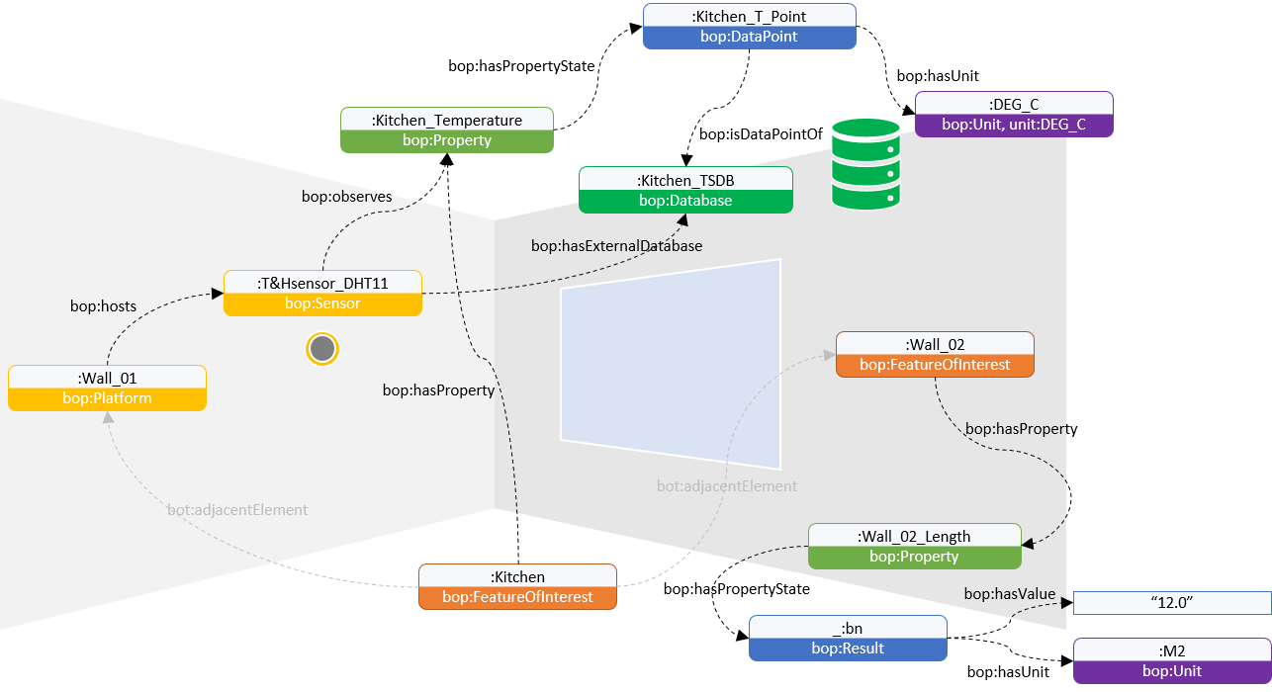
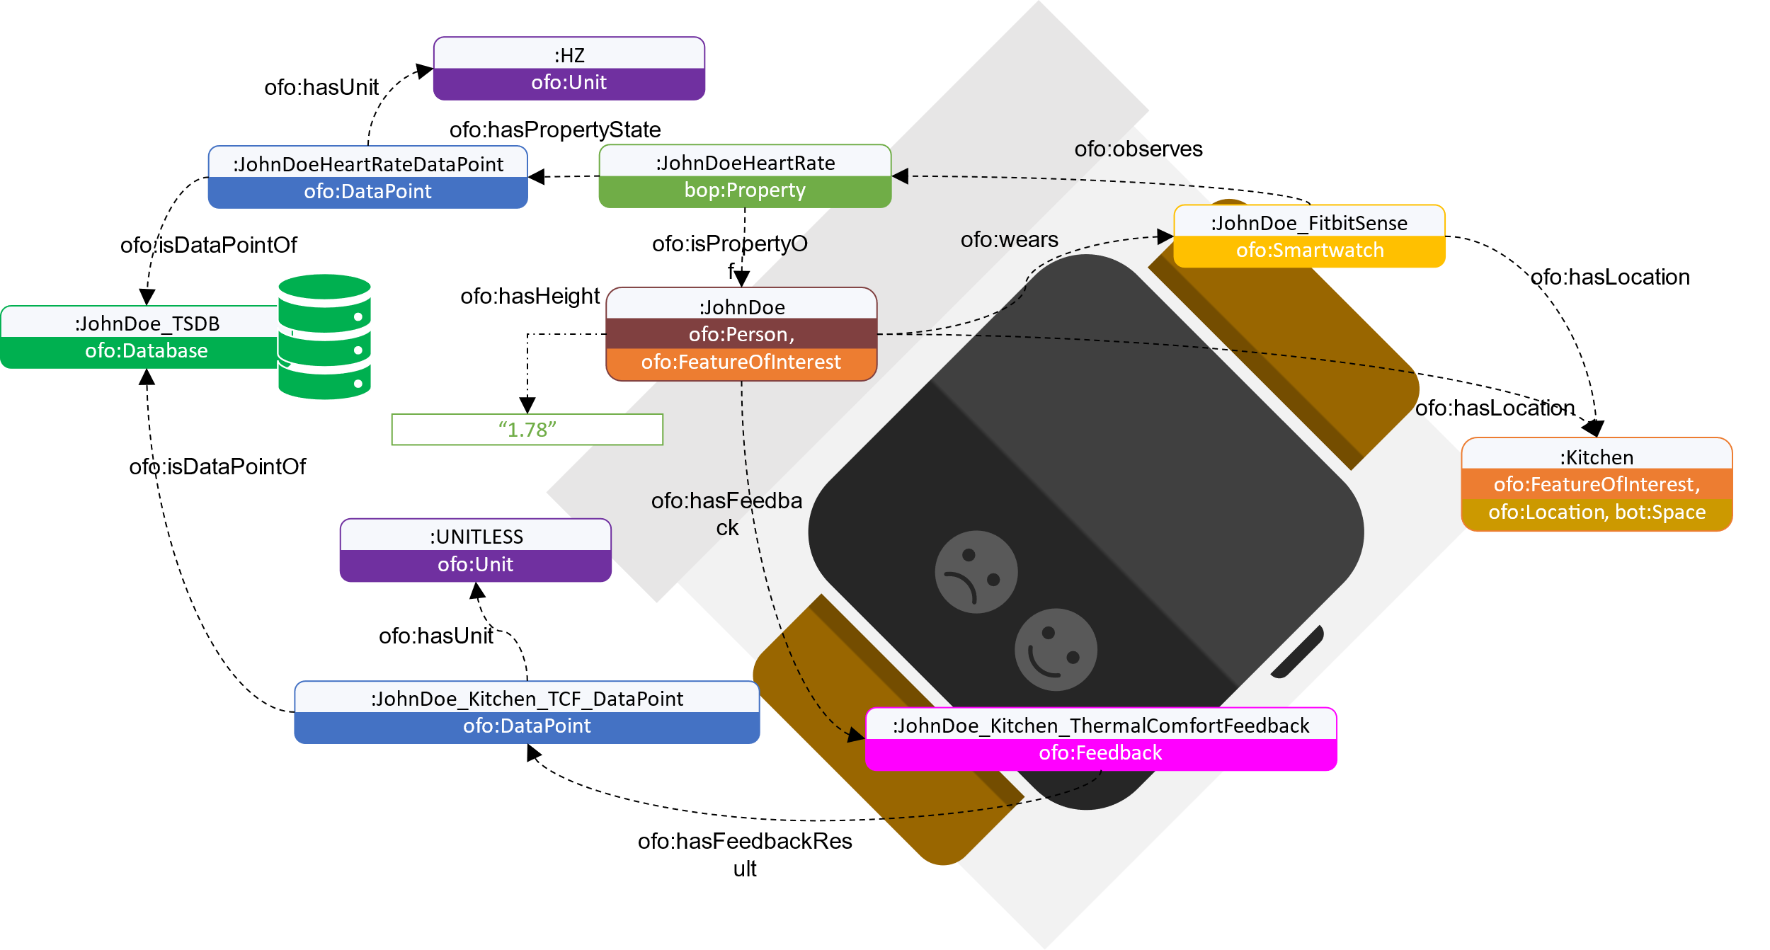
Integrating feedback and LBD
Perceived building performance
Measured building performance

Slide 34
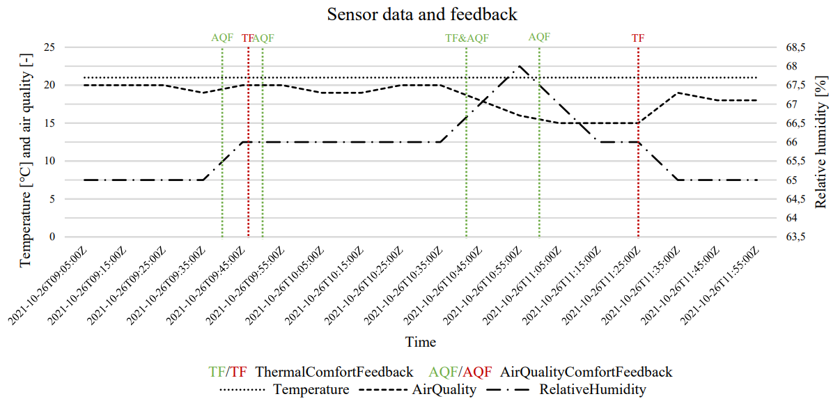
What can it do?

Slide 35
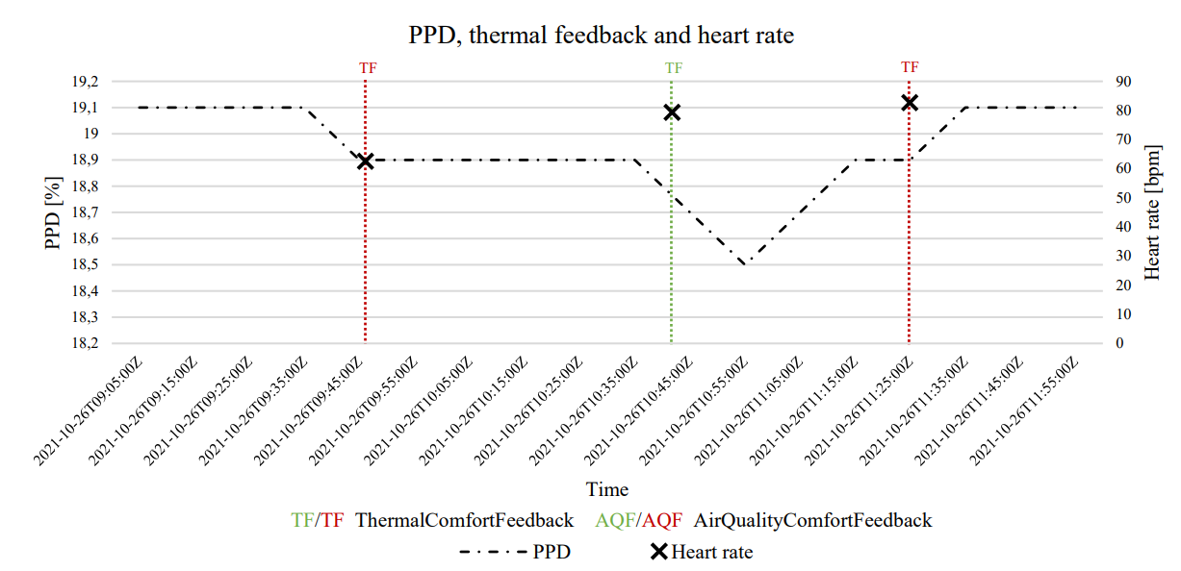
What can it do?

Slide 36
How to create parallel intelligence?

Slide 37






Process
KDD PROCEDURE
Step 1
\
\

Slide 38


Case study 1
3 weeks
2 occupants
Feedback
Sensor data
Weather data
Building information
Living room
Office space
time; ch-001; ch-002; …; ch-020; weather; outdoor temperature; outdoor wind speed; outdoor humidity; outdoor air pressure; outdoor visibility; thermal comfort feedback; air quality feedback; visual comfort feedback; building; location; floor area; room type; window/wall ratio; energylabel; occupant; heartrate; age; weight; length;
23-1-2022 17:45:00 48.85; 1.15; 2.422; Overcast; 4; 6; 81; 1034; 6; 1; 1; 0; OpenFamilyHome; LivingRoom; 52,14; LivingRoom; 0.203; A; JohnDoe; 78; 27; 72; 179;

Slide 39
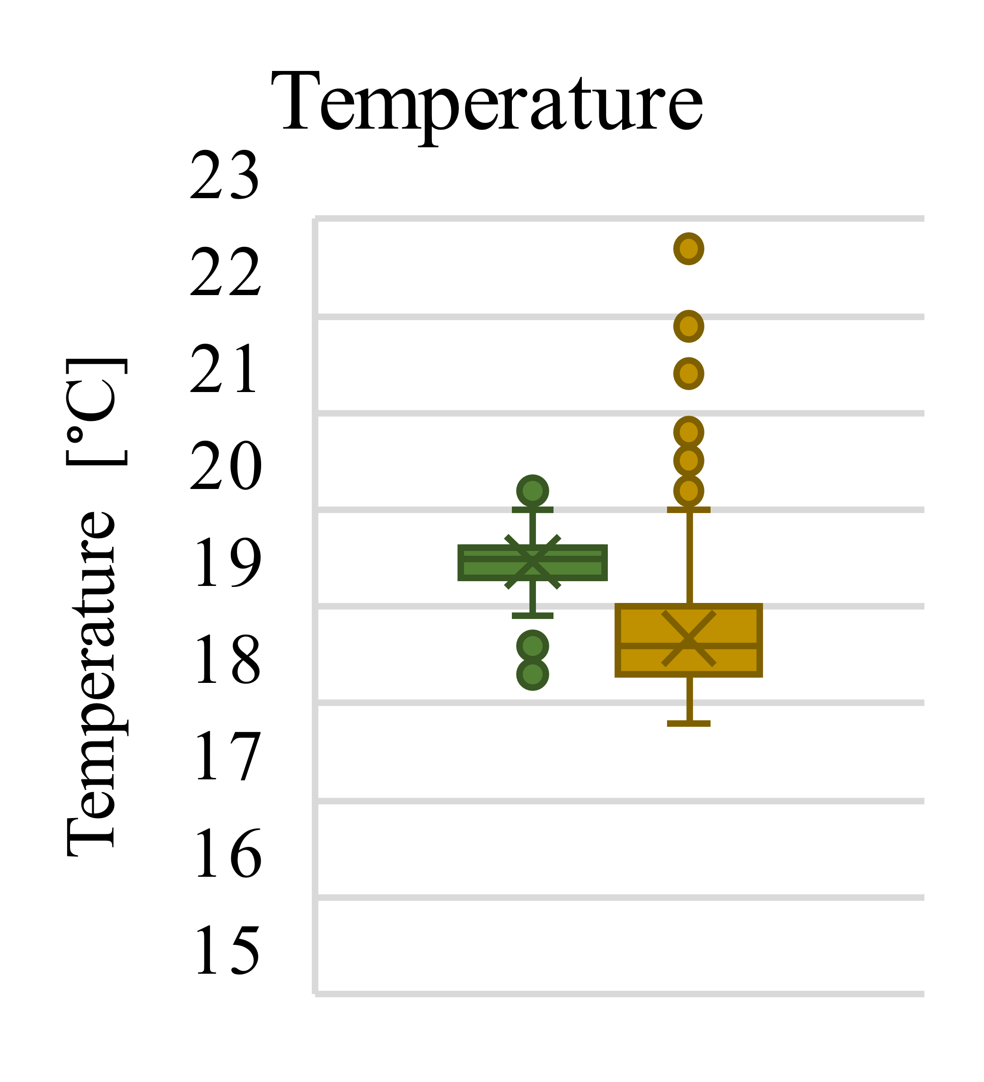
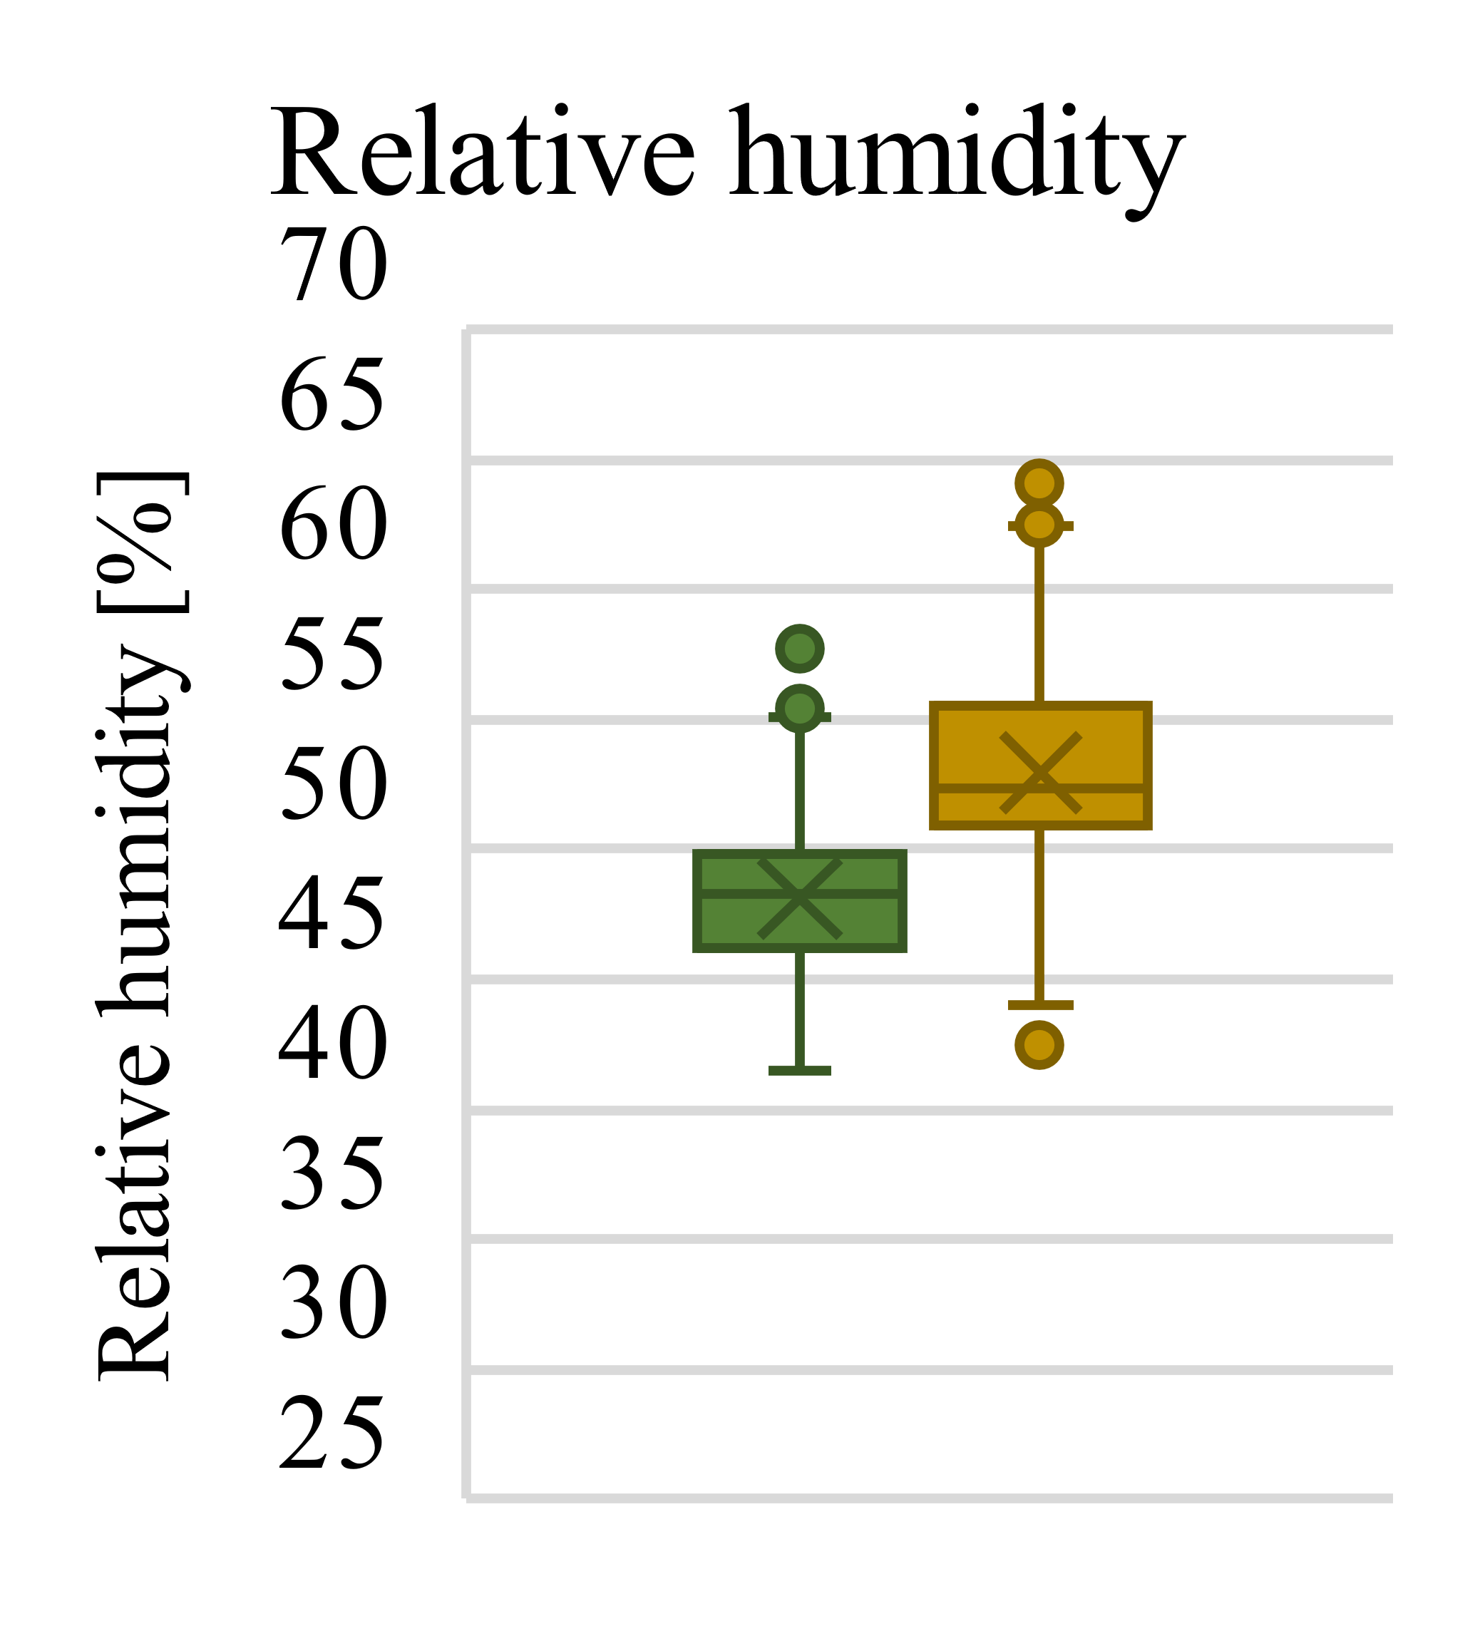
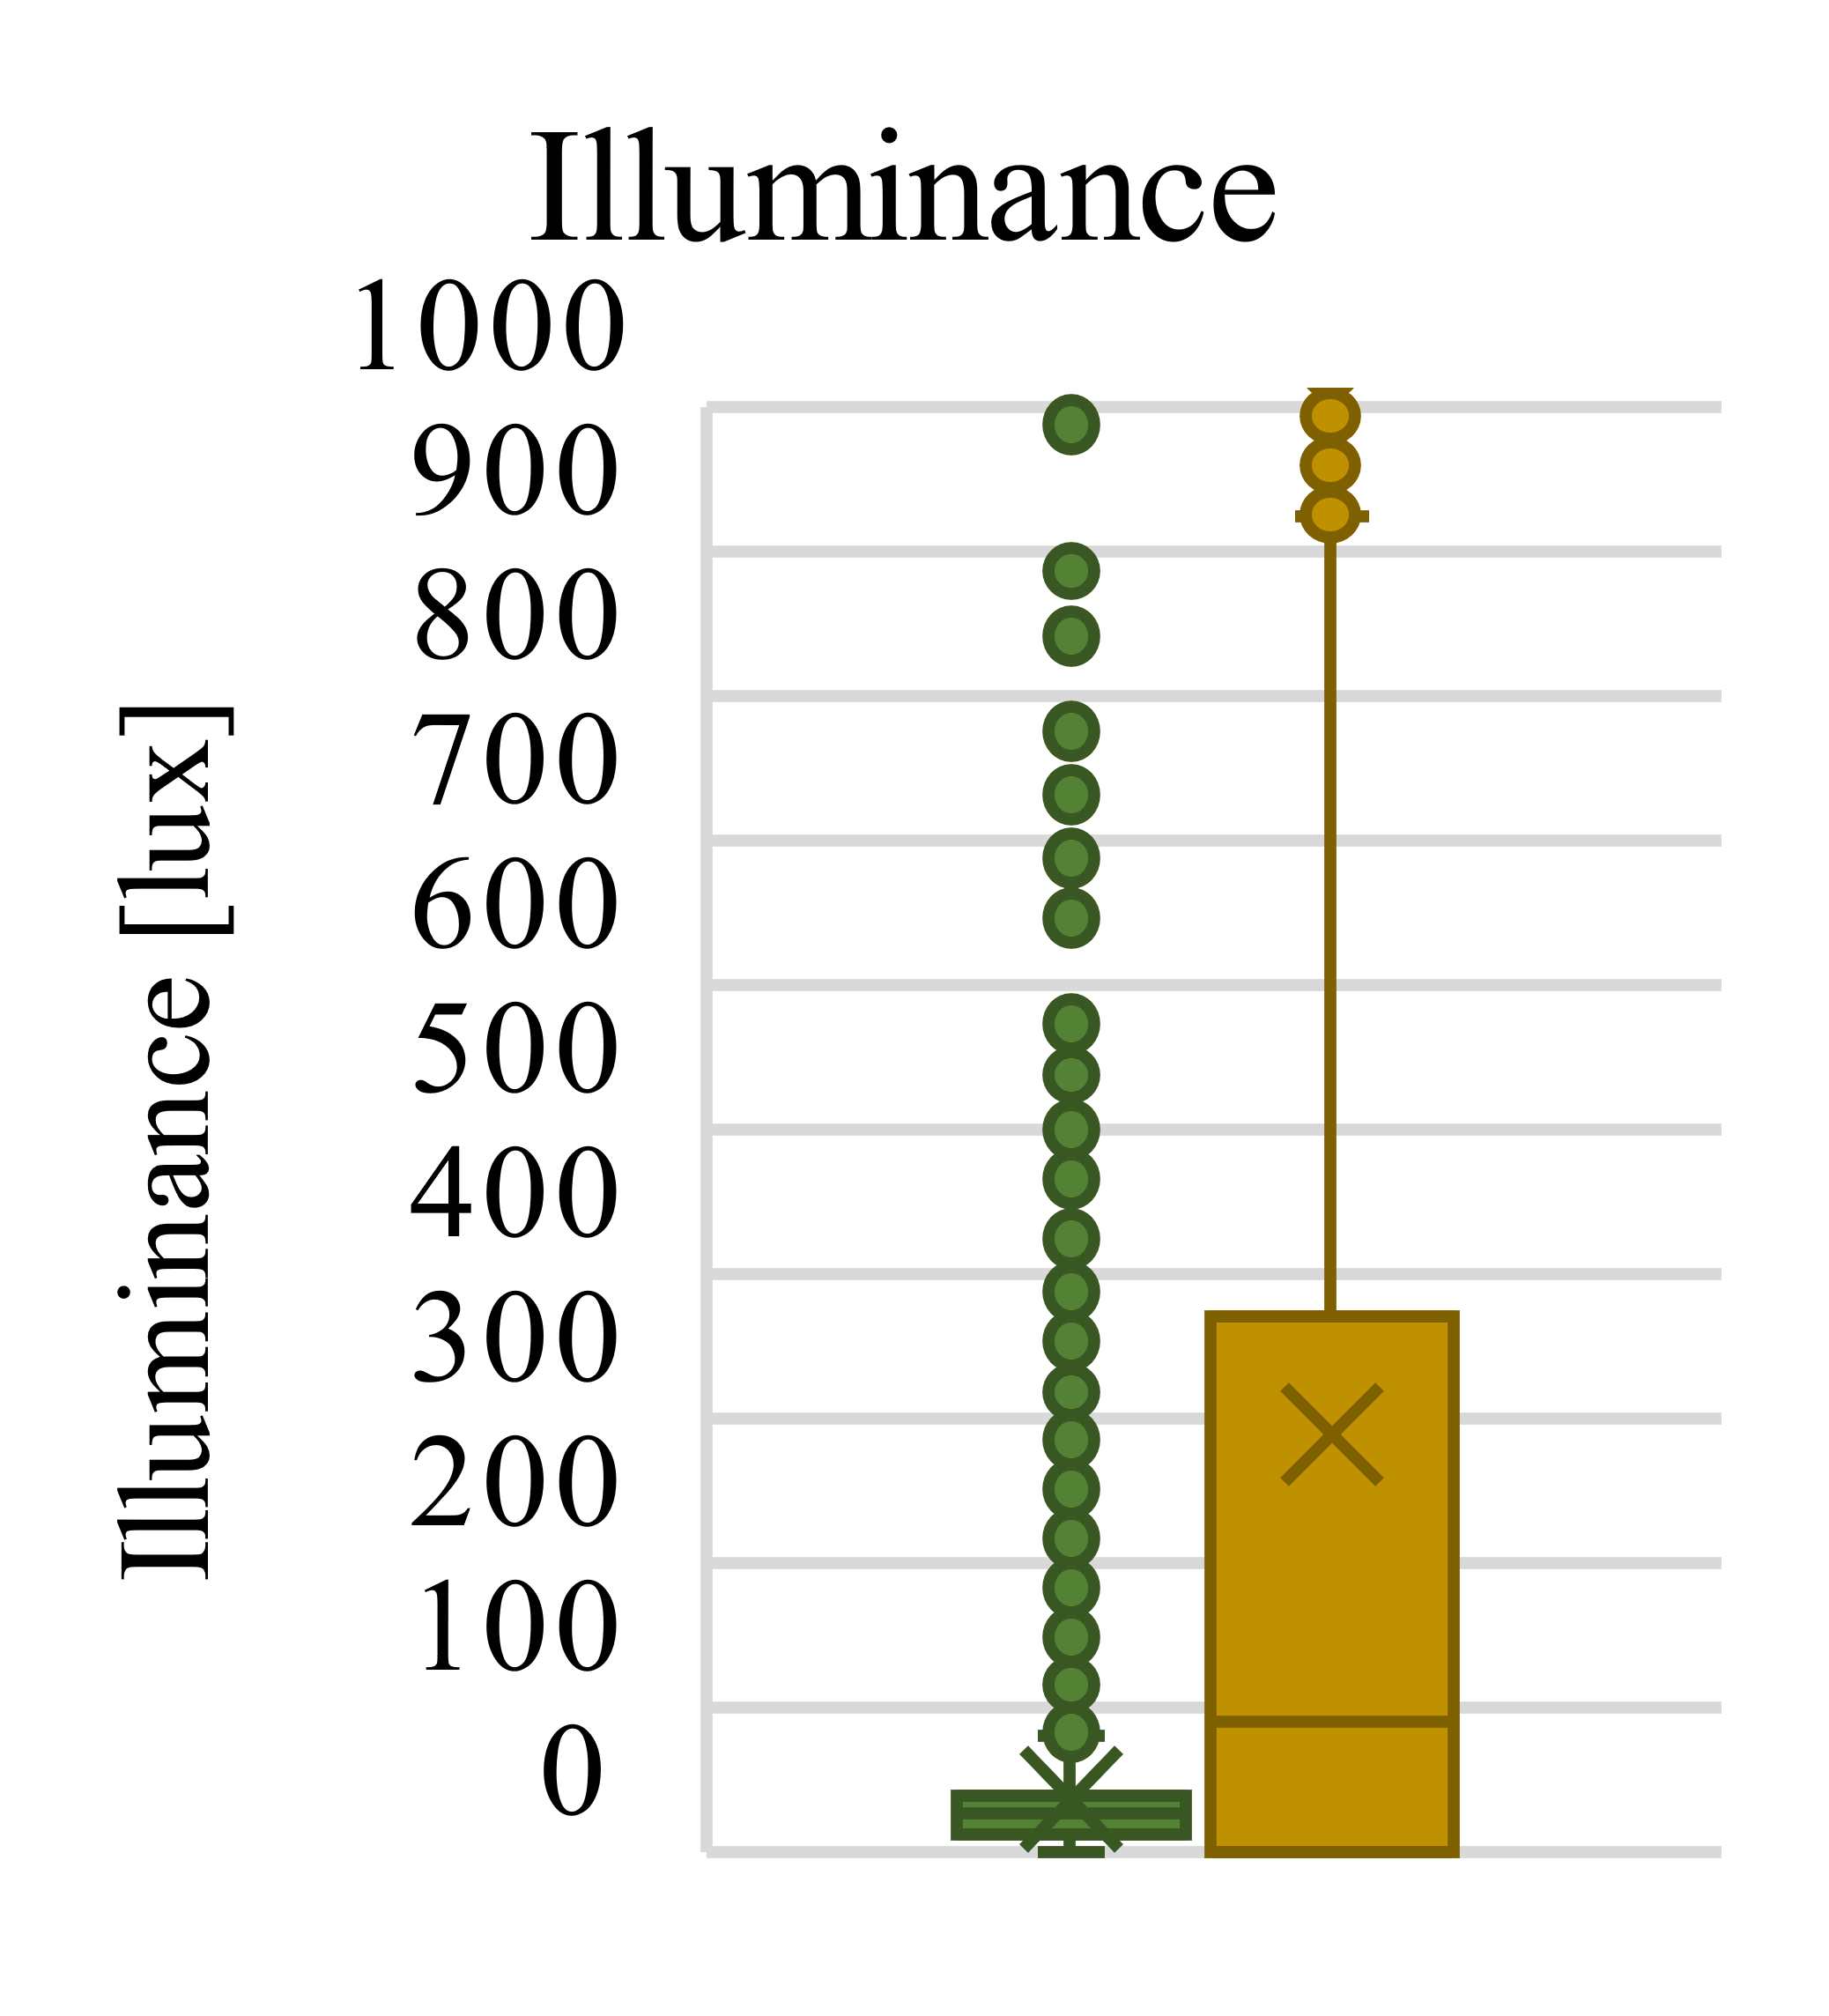
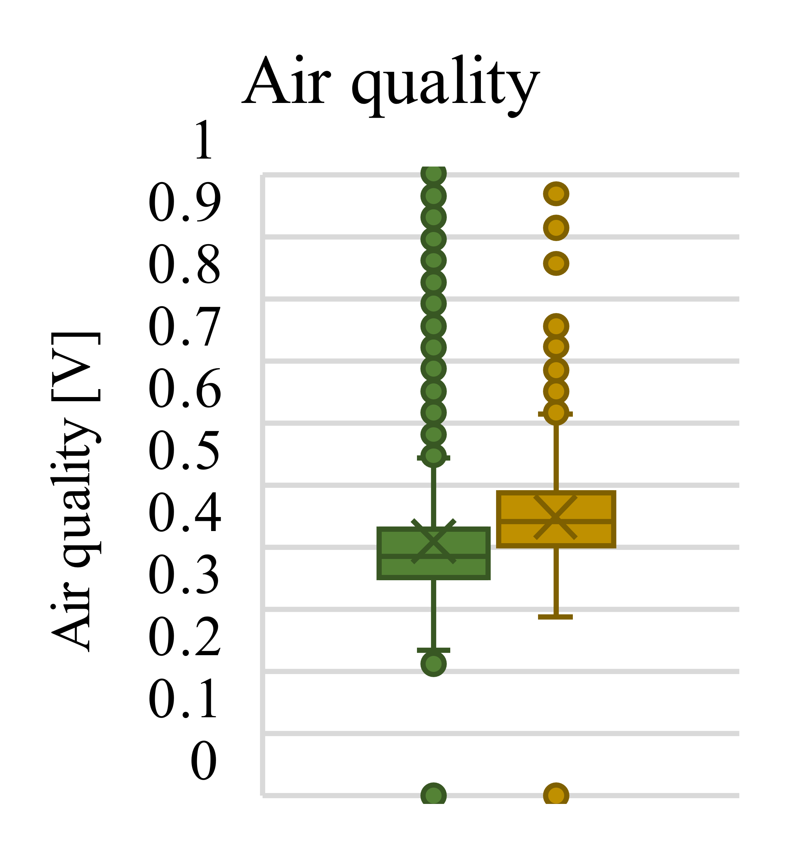
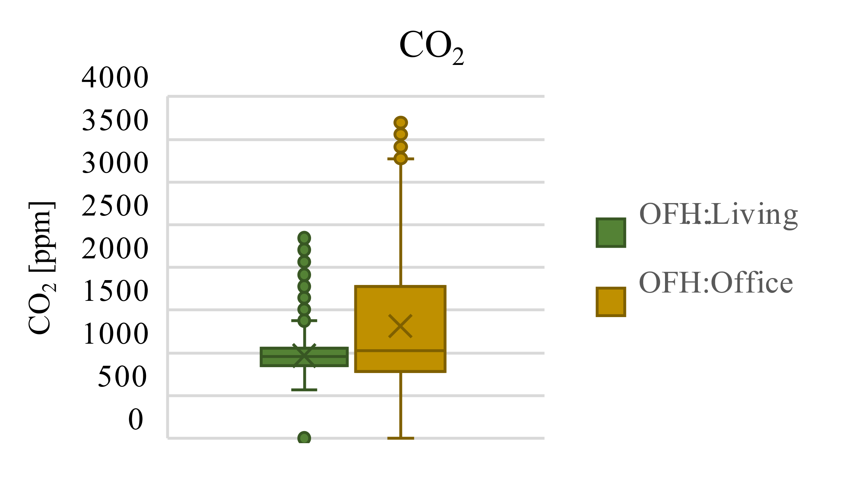
Case study 1: Comparing IEQ performance
We can compare individual building parameters as well

Slide 40
Case study 1: Individual thermal comfort

Slide 41
Case study 1: Individual visual comfort

Slide 42
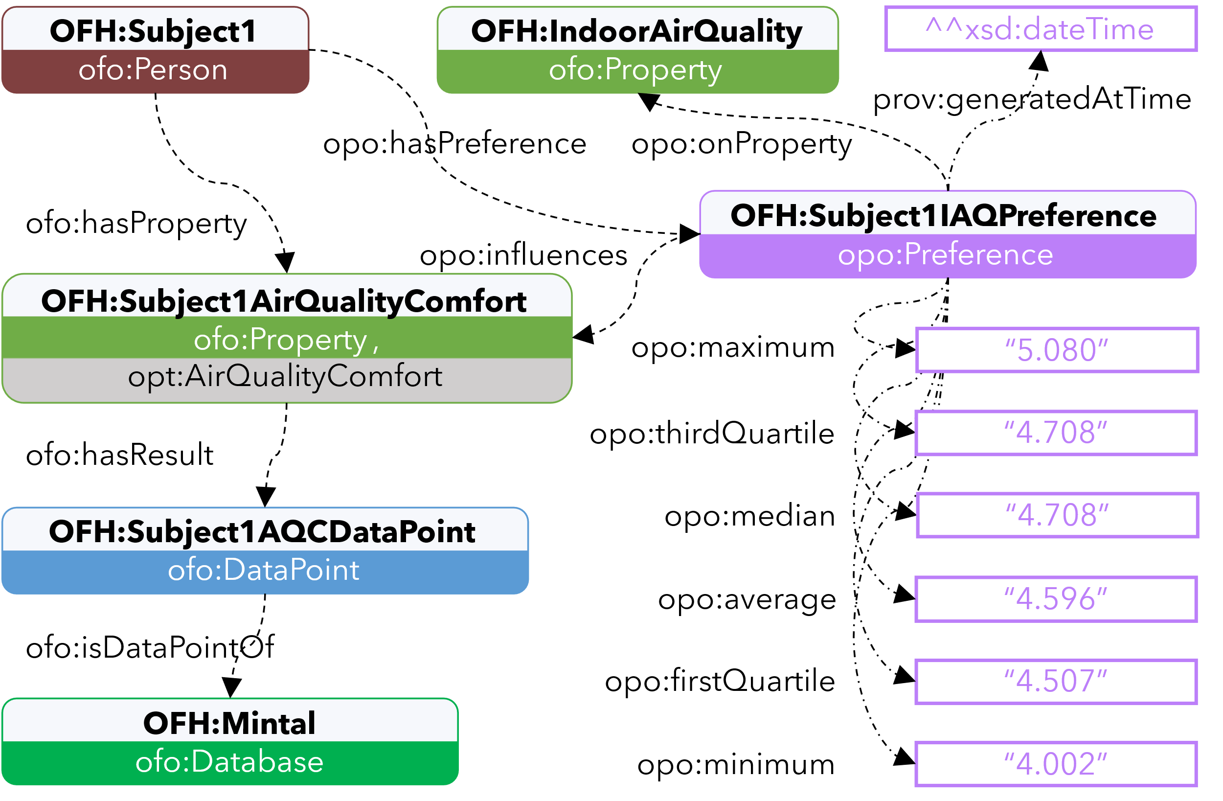
Case study 1: Knowledge integration
PREFIX OFH: <https://github.com/AlexDonkers/OpenFamilyHome#>
PREFIX opo: <https://alexdonkers.github.io/opo#>
PREFIX prov: <http://www.w3.org/ns/prov#>
SELECT ?firstQuartile ?thirdQuartile
WHERE { OFH:Subject1 opo:hasPreference ?preference .
?preference opo:onProperty OFH:IndoorAirQuality .
?preference prov:generatedAtTime ?time .
?preference opo:firstQuartile ?firstQuartile .
?preference opo:thirdQuartile ?thirdQuartile . }
ORDER BY DESC(?time) LIMIT 1

Slide 43
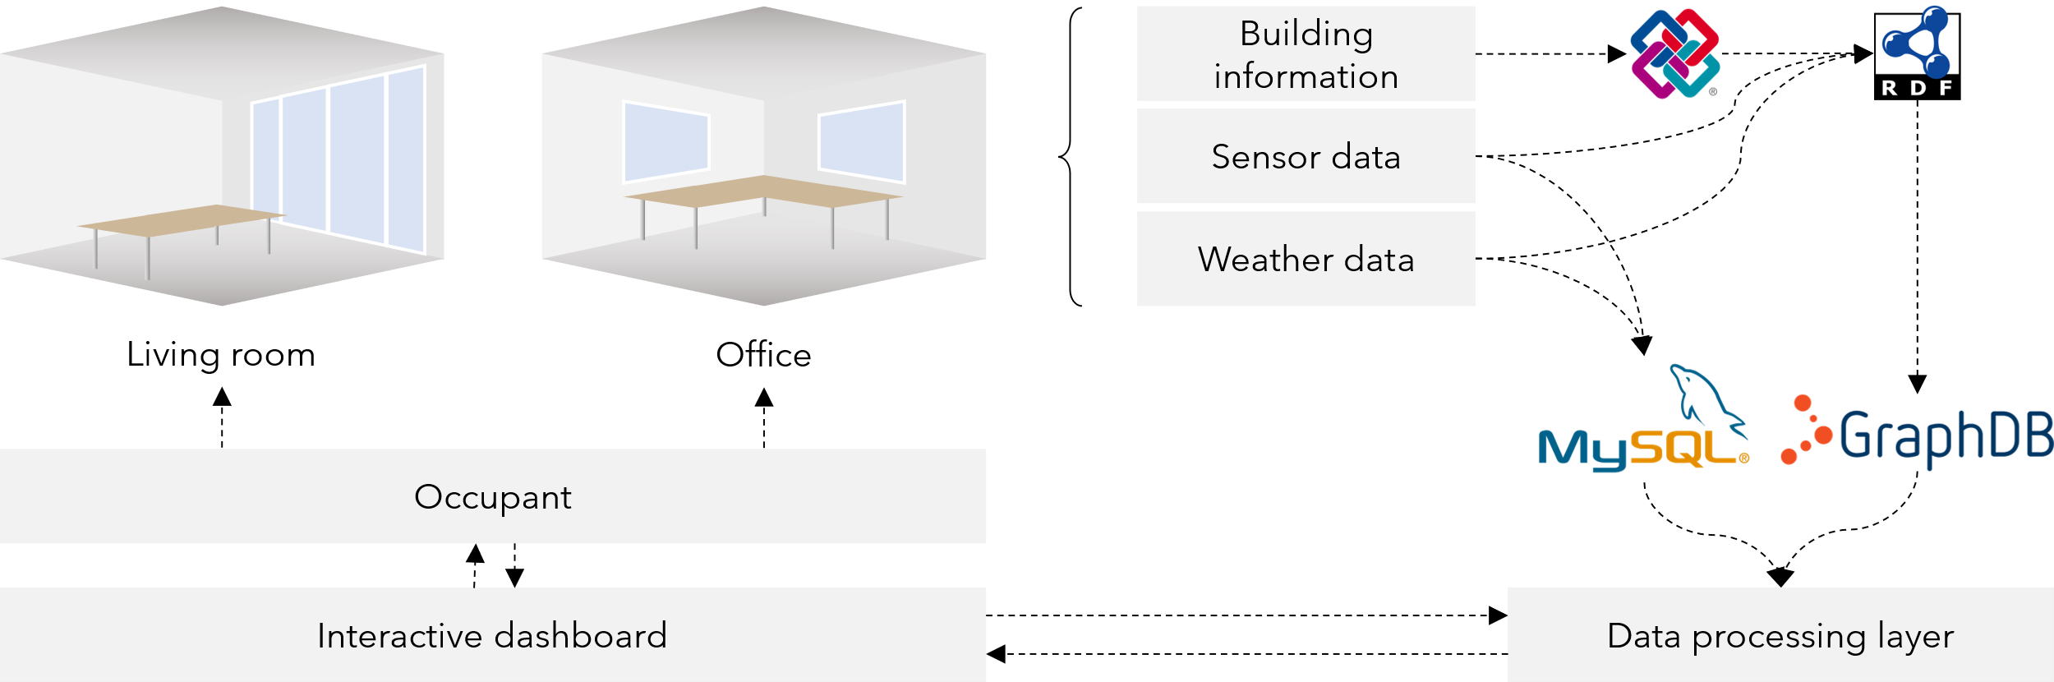
Case study 2

Slide 44
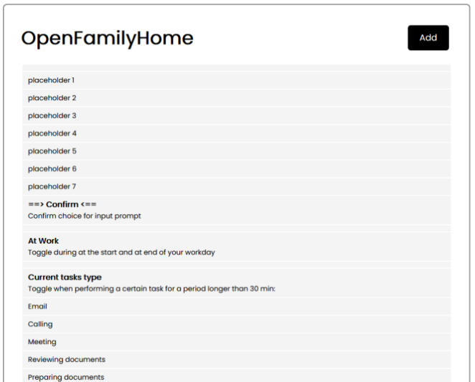
Case study 2: The interactive dashboard
TIPS
pop up when the measured value of a parameter exceeds predefined threshold values.
DIRECT FEEDBACK
can be given at any time to comment on the current state of a parameter (negative, neutral, or positive tag)
MICROSURVEYS
the dashboard actively asks the occupant to give feedback on random parameters to reduce bias

Slide 45
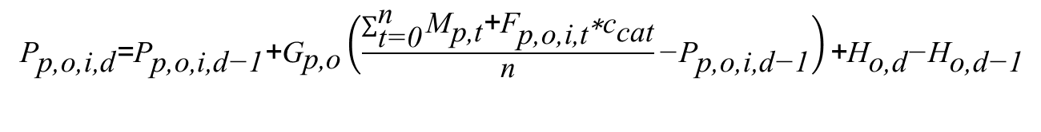
Case study 2: Equation
Preferred value
Measured value
Feedback on value
Health correction
${\text{P}}_{\text{p}\text{,}\text{o}\text{,}\text{i}\text{,}\text{d}}\text{=}{\text{P}}_{\text{p}\text{,}\text{o}\text{,}\text{i}\text{,}\text{d}\text{−}\text{1}}\text{+}{\text{G}}_{\text{p}\text{,}\text{o}}\left(\frac{\sum_{\text{t}\text{=}\text{0}}^{\text{n}}{{\text{M}}_{\text{p}\text{,}\text{t}}\text{+}{\text{F}}_{\text{p}\text{,}\text{o}\text{,}\text{i}\text{,}\text{t}}\text{∗}{\text{c}}_{\text{cat}}}}{\text{n}}\text{−}{\text{P}}_{\text{p}\text{,}\text{o}\text{,}\text{i}\text{,}\text{d}\text{−}\text{1}}\right)\text{+}{\text{H}}_{\text{o}\text{,}\text{d}}\text{−}{\text{H}}_{\text{o}\text{,}\text{d}\text{−}\text{1}}$
Old preferred value

Slide 46
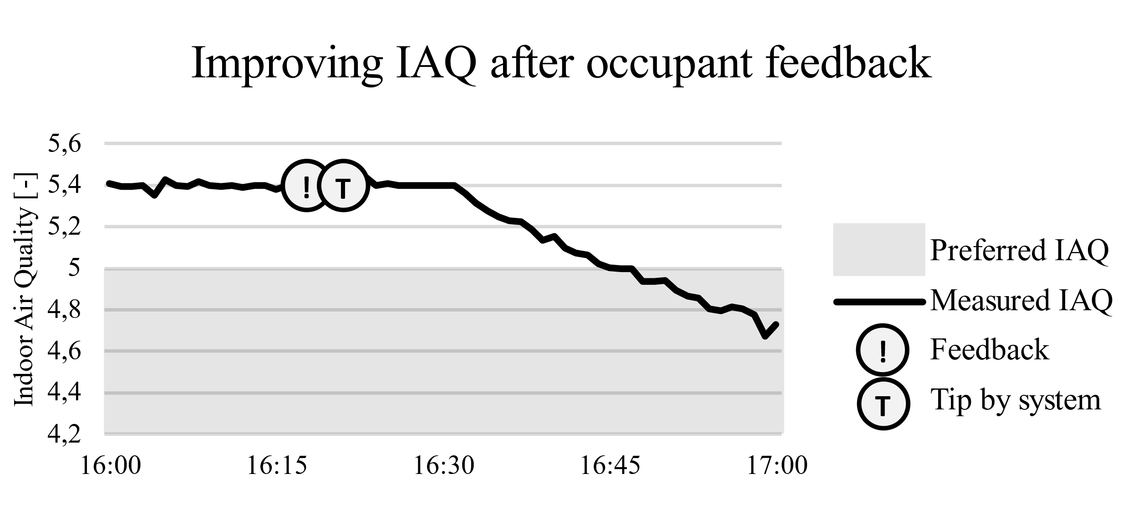
Case study 2: Results

Slide 47
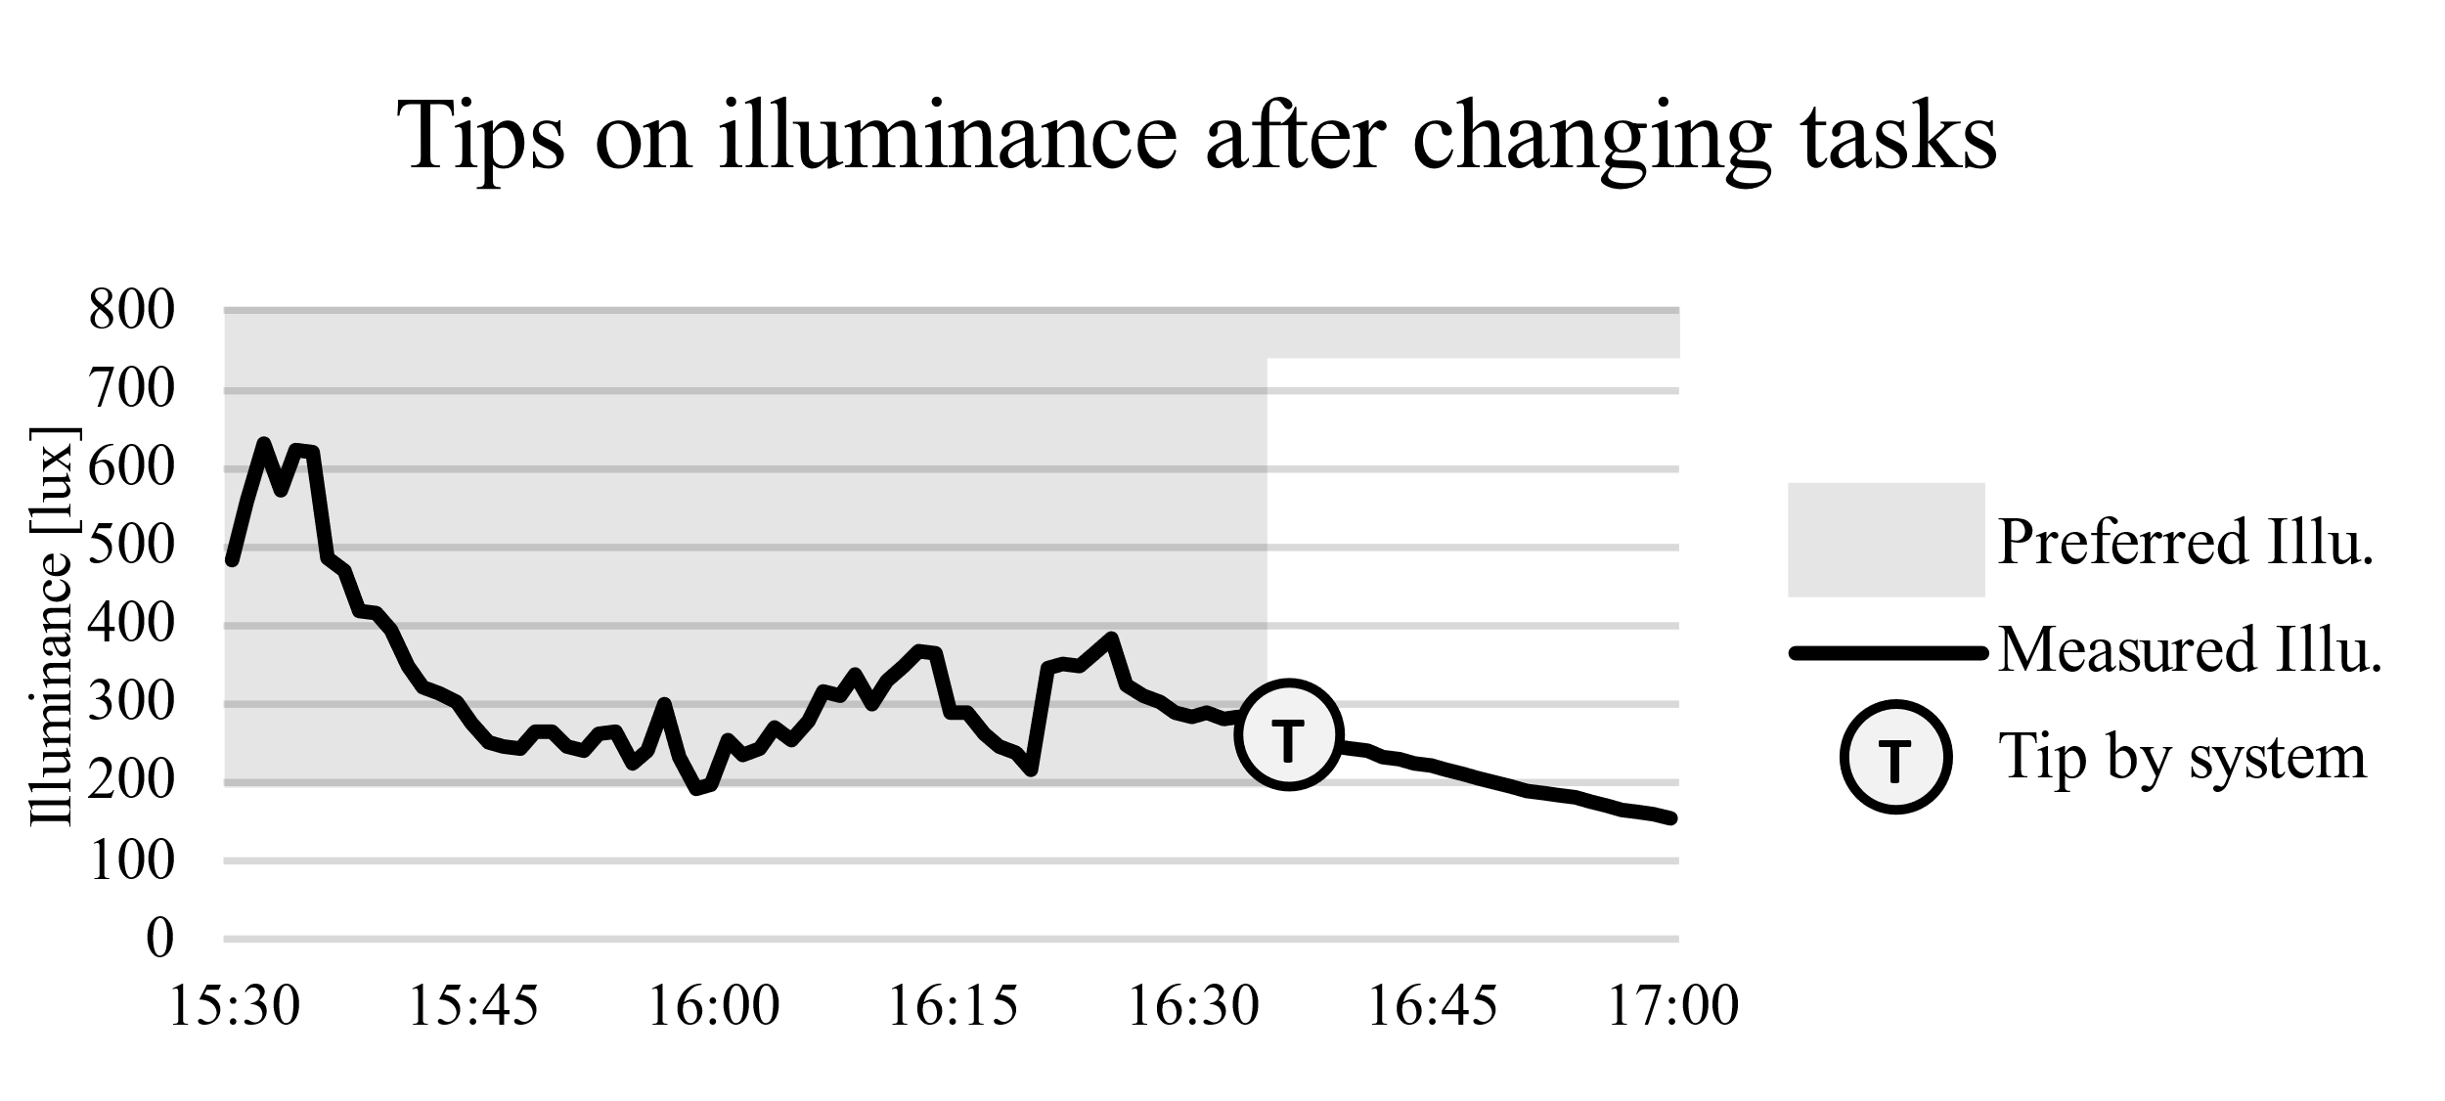
Case study 2: Results

Slide 48
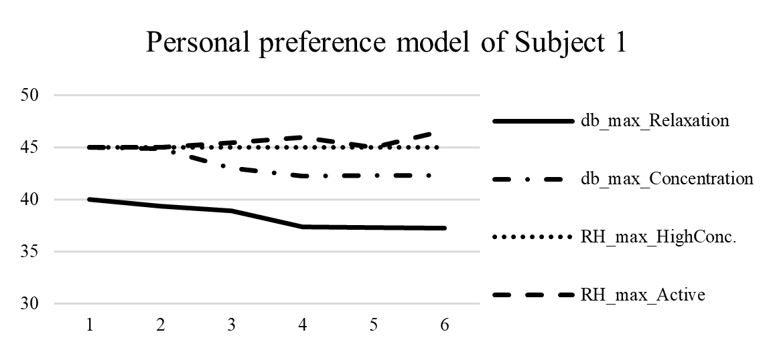
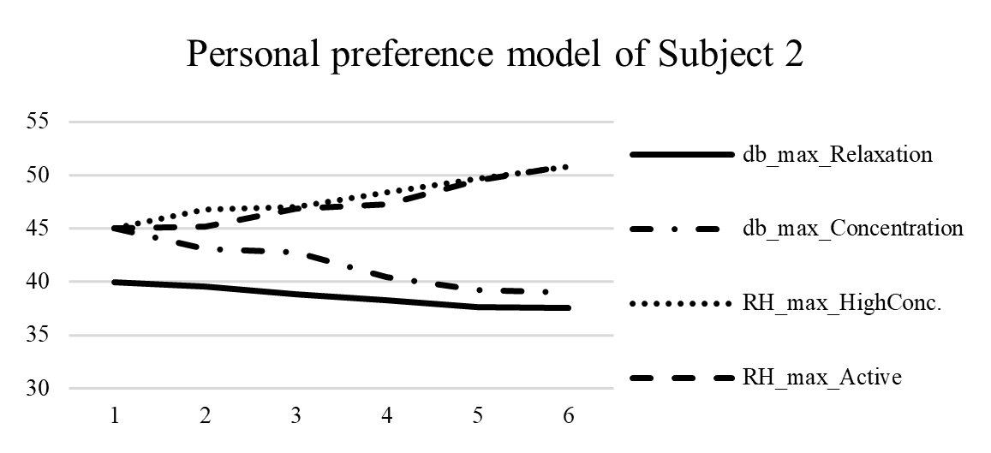
Case study 2: Personal preference models

Slide 49
Current work

Slide 50
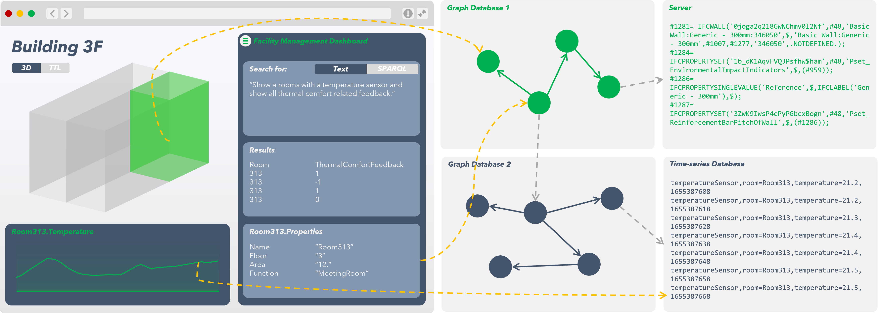

Slide 51
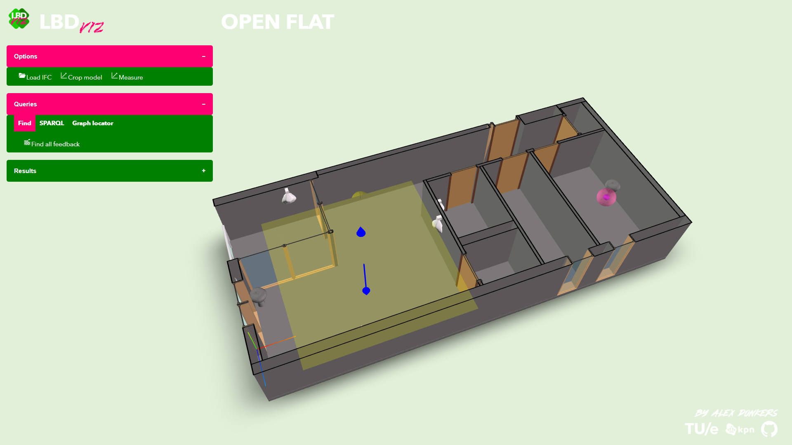

John Doe, 17:00 24-06-2022
“I like this lamp!”

Slide 52
Next up
Actuation
More buildings
KDD PROCEDURE
Machine learning
More occupants
Step 1
More sensors
\
\

Slide 53

Resources!
Ontologies
BOP: https://w3id.org/bop
OFO: https://w3id.org/ofo
Open data
Open smart home: https://github.com/AlexDonkers/ofo/tree/main/docs/OpenSmartHome
Open flat: https://github.com/AlexDonkers/ofo/tree/main/docs/OpenFlat
Open family home: on github soon
Papers
Real-Time Building Performance Monitoring using Semantic Digital Twins: http://ceur-ws.org/Vol-3081/05paper.pdf
Knowledge Discovery Approach to Understand Occupant Experience in Cross-Domain Semantic Digital Twins: https://linkedbuildingdata.net/ldac2022/files/papers/paper07.pdf
Linked Data for Smart Homes: Comparing RDF and Labeled Property Graphs: http://ceur-ws.org/Vol-2636/02paper.pdf
Creating Occupant-Centered Digital Twins Using the Occupant Feedback Ontology Implemented in a Smartwatch App [under review]: http://www.semantic-web-journal.net/system/files/swj3158.pdf
Parallel Intelligence in Semantic Digital Twins: An Interactive Decision-Support System for Indoor Comfort: email for pre-print
Automated safety checking in subway construction via semantic web technology and building information modeling [accepted]: Automation in Construction, soon online
Alex Donkers – PhD Candidate at Eindhoven University of Technology – a.j.a.donkers@tue.nl
Dujuan Yang, Bauke de Vries, Nico Baken

